Slide 1
Part 2: AC Circuits
Sinusoids and Phasors
Sinusoidal Steady-State Analysis
AC Power Analysis
Three-Phase Circuits
Magnetically Coupled Circuits

Slide 2
Chapter 13 Magnetically Coupled Circuits
Introduction
Mutual Inductance
Energy in a Coupled Circuit
Linear Transformers
Ideal Transformers

Slide 3
Chapter objectives
Understand magnetically coupled circuits
Learn the concept of mutual inductance
Learn how to analyze magnetically coupled circuits

Slide 4
Key points
Understand the concept of mutual inductance
Know how to determine the reference polarity of the mutual voltage
Know how to analyze circuits involving linear and ideal transformers

Slide 5
Difficult points
The reference polarity of the mutual voltage
The analyzing method of magnetically coupled circuits

Slide 6
13.1 Introduction
What is a transformer?
It is an electrical device designed on the basis of the concept of magnetic coupling
It uses magnetically coupled coils to transfer energy from one circuit to another
It is the key circuit element for stepping up or stepping down ac voltages or currents, impedance matching, isolation, etc.

Slide 7
13.2 Mutual Inductance
1. Self-inductance
2. Mutual Inductance
3. The VCR of mutual coils

Slide 8
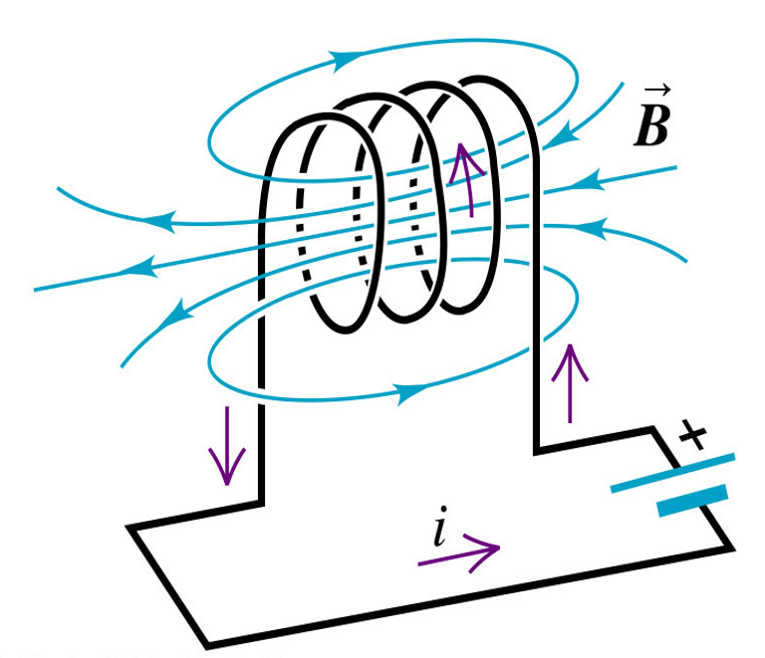
1. Self-inductance
A coil of wire with a changing current can produce an electromotive force (EMF) within itself. (Faraday’s induction Law)
This EMF will oppose whatever is causing the changing current (LENZ’S Law)
So a coil of wire takes on a special name called the inductor

Slide 9
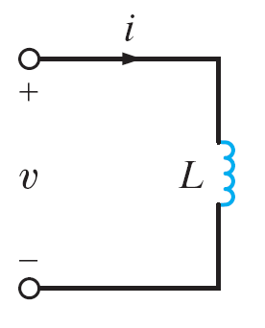
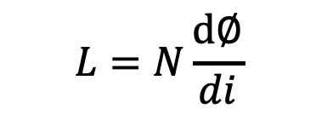

Ideal inductor symbol
According to the right hand rule
Where
v = (Instantaneous) induced voltage in volts
N = Number of turns of coil
= Magnetic flux in Webers
Ψ = Flux linkage
$$L=N\frac{d∅}{di}$$
Self-inductance L

Slide 10
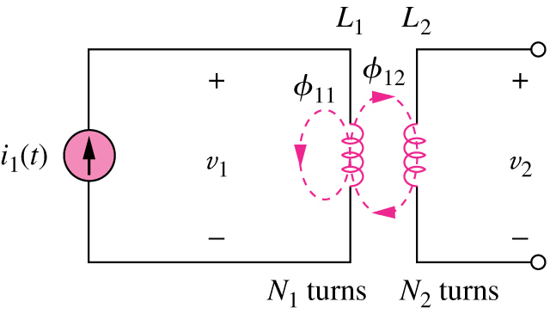
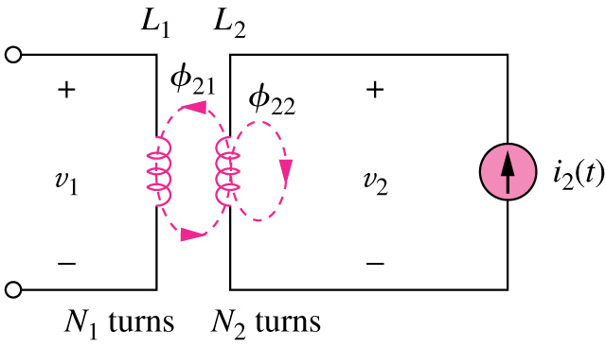
2. Mutual inductance
It is the ability of one inductor to induce a voltage across a neighboring inductor, measured in henrys (H).
The open-circuit mutual voltage across coil 2
The open-circuit mutual voltage across coil 1

Slide 11
M₂₁ = M₁₂ =M : Mutual inductance, M>0. （Henrys）

Slide 14
The dot convention
i₁
M
i₂
+
•
•
+
v₁
L₁
L₂
v₂
_
_
dots are placed beside each coil (inductor) so that if both currents are entering (or leaving) the dotted terminals, then the fluxes will be added.
We need dots on the schematic to know how the coils are physically oriented with respect to one another

Slide 15
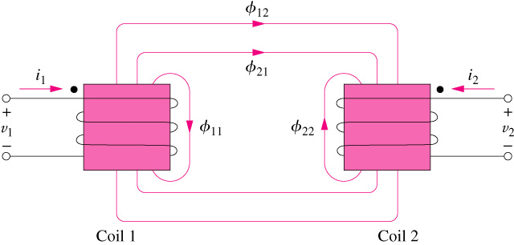
The dot convention
If a current enters (leaves) the dotted terminal of one coil, the reference polarity of the mutual voltage in the second coil is positive (negative)at the dotted terminal of the second coil.
Illustration of the dot convention

Slide 16
Examples
Determine the sign of the mutual voltage
How to place dots for two magnetically coupled coils?

Slide 17
Steps:
1.Assume a current enters one terminal of coil 1, place a dot at that terminal.
2. Apply the right hand rule and find the direction of the flux that links coil 2.
3. Use the right hand rule to determine the dotted terminal of coil 2 since the fluxes will be added if both currents enter the dotted terminals respectively, place a dot at that terminal for coil 2.
For example:
i
Φ
1
2
3
1
2
•
*
Δ
*
*
*
1'
2'
3'
1'
2'
•
Δ
If two or more coils are coupled with one another, the dot-pairs should be marked with different symbols.

Slide 18
3. The VCR of mutual coils
i₁
M
i₂
When both coils are energized, the voltage of each coil can be found by superposition; in each coil, the induced voltage is the sum of its self-voltage plus the voltage mutually induced due to the current in the other coil.
+
*
*
+
u₁
L₁
L₂
u₂
_
_

Slide 19
i₁
M
i₂
+
*
*
+
u₁
L₁
L₂
u₂
_
_
In frequency domain
+
+
jω L₁
jω L₂
The mutual voltage can be represented by CCVS.
+
+
–
–
–
–

Slide 20
Dot convention for coils in series
1. Series-aiding connection
i
R₁
i
+
+
*
+
u₁
L₁
R
M
u
–
u
+
*
L₂
L
u₂
–
–
–
R₂

Slide 21
2. Series-opposing connection
i
R₁
i
+
+
*
+
u₁
L₁
R
u
–
M
u
+
u₂
L₂
L
–
–
–
*
R₂

Slide 22
Dot convention for coils in parallel
1. Parallel-aiding connection
i
M
+
i₁
i₂
*
*
u
L₁
L₂
–
i = i₁ +i₂
Solve the equations, we get

Slide 23
2. Parallel-opposing connection
i
M
+
i₁
i₂
*
u
L₁
L₂
–
i = i₁ +i₂
*
Solve the equations, we get

Slide 24
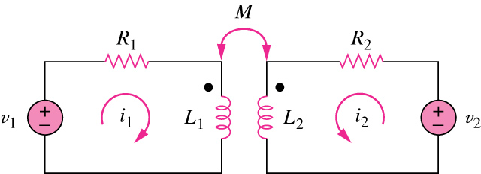
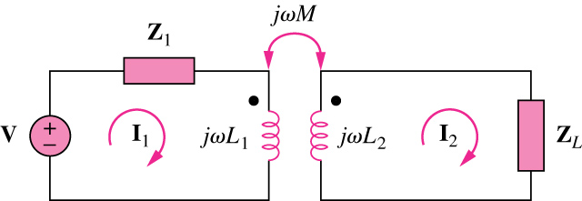
Time-domain analysis of a circuit containing coupled coils.
Frequency-domain analysis of a circuit containing coupled coils

Slide 25
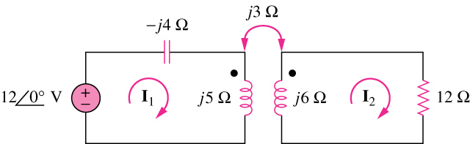
Example 1
Calculate the phasor currents I₁ and I₂ in the circuit shown below.
Ans:

Slide 26
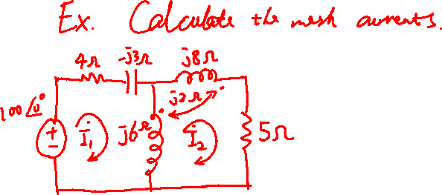

Slide 27
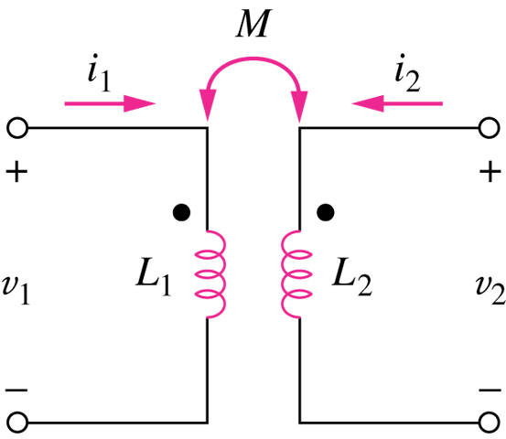
13.3 Energy in a Coupled Circuit
The coupling coefficient, k, is a measure of the magnetic coupling between two coils; 0≤k≤1.
k = 1 perfectly coupled;
k < 0.5 loosely coupled;
k > 0.5 tightly coupled.

Slide 28



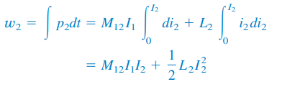

i₁=I₁, i₂:0~I₂
The mutual voltage induced in coil 1:
The mutual voltage induced in coil 2 is zero since i₁ does not change.
The power in the coils:
Review:
Energy stored in an inductor:
The energy stored in the circuit:
Assume i₁:0~I₁, i₂=0
The power in coil 1:
The energy stored in the circuit:

Slide 29





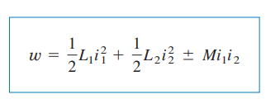
The total energy stored in the coils when both i₁ and i₂ have reached constant values
Reverse the order by which the currents reach their final values, the total energy stored in the coils
The total energy should be the same
If one current enters one dotted terminal, the other current leaves the other dotted terminal, the mutual voltage is negative, the mutual energy MI₁I₂ is also negative
The general expression of the instantaneous energy stored in the circuit

Slide 30
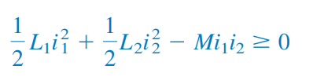



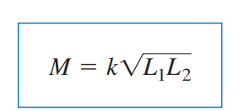

The energy stored in the circuit
Coefficient of coupling k: the extent to which M approaches the upper limit

Slide 31
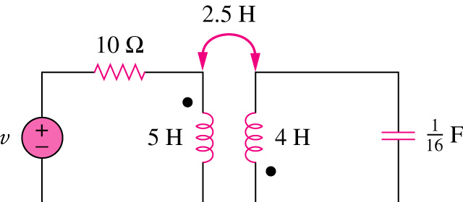
Example 2
Consider the circuit below. Determine the coupling coefficient. Calculate the energy stored in the coupled inductors at time t = 1s if v=60cos(4t +30°) V.
Ans: k=0.56; w(1)=20.73J

Slide 32
13.4 Linear Transformers
What is a transformer?
It is an electrical device designed on the basis of the concept of magnetic coupling
It uses magnetically coupled coils to transfer energy from one circuit to another
It is the key circuit element for stepping up or stepping down ac voltages or currents, impedance matching, isolation, etc.

Slide 33
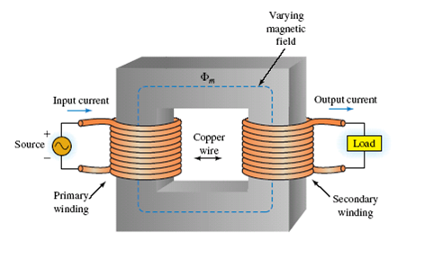
Linear Transformers
It is generally a four-terminal device comprising two (or more) magnetically coupled coils

Slide 34
Equivalent circuit for primary winding
jω M
R₁
R₂
Z₁₁
+
*
*
+
jω L₁
jω L₂
Z=R+jX
–
–
Z₁₁=R₁+jω L₁， Z₂₂=(R₂+R)+j(ω L₂+X)， Z_{M}=jω M

Slide 35
Z₁₁
+
–
Reflected impedance, which reflects the secondary impedances into the primary

Slide 36
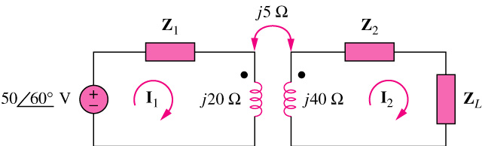
Example 3
In the circuit below, calculate the input impedance and current I₁. Take Z₁=60-j100Ω, Z₂=30+j40Ω, and Z_{L}=80+j60Ω.
Ans:

Slide 37
The equivalent T circuit of a linear transformer
L₁–M
L₂–M
i₂
i₁
M
i₂
i₁
i₂
i₁
i₁ +i₂
+
*
*
+
i₁ +i₂
u₁
L₁
L₂
u₂
M
M
_
_
L₁–M
L₂–M
L₂+M
i₁
M
i₂
i₁
i₂
i₁
L₁+M
i₂
+
*
+
i₁ +i₂
i₁ +i₂
u₁
L₁
L₂
u₂
-M
-M
_
_
*
L₁+M
L₂+M

Slide 38
Tee Model
(a) Dots on the same sides
jω M
1
2
1
2
*
*
jω L₁
jω L₂
jω (L₁–M)
jω (L₂–M)
jω M
3
3

Slide 39
(b) Dots on opposite sides
jω M
1
2
1
2
*
jω L₁
jω L₂
jω (L₁+M)
jω (L₂+M)
*
-jω M
3
3

Slide 40
Equivalent circuits without magnetic coupling
1）series：equivalent inductor，L = L₁ + L₂ ± 2M
series aiding connection for “+”，otherwise for “－”
2）parallel：equivalent inductor，
parallel aiding connection for “－” ，otherwise for “+”
3）Tee model
jω M
1
2
1
2
•
*
*
jω L₁
jω L₂
jω (L₂–M)
jω (L₁–M)
＋
＋
•
Dots on same sides
Dots on opposite sides
jω M
3
3

Slide 41
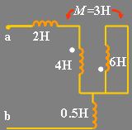
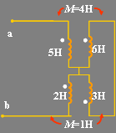
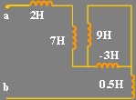
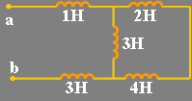


Ex.1
Find the equivalent inductance L_{ab} of circuit (a)、(b)
（a）
（b）

Slide 42
Decoupled equivalent circuits
M₁₂
L₁
L₂
L₁–M₁₂
L₂–M₁₂
•
•
Δ
*
Δ
*
L₃
L₃+M₁₂
M₁₃
M₂₃
M₁₃
M₂₃
Δ
*
Δ
*
L₁–M₁₂ +M₂₃ –M₁₃
L₂–M₁₂–M₂₃ +M₁₃
L₁–M₁₂ +M₂₃
L₂–M₁₂ –M₂₃
Δ
L₃+M₁₂–M₂₃ –M₁₃
M₁₃
L₃+M₁₂ –M₂₃
Δ

Slide 44
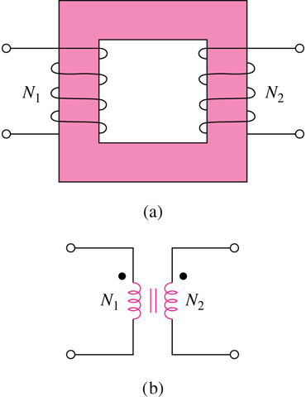
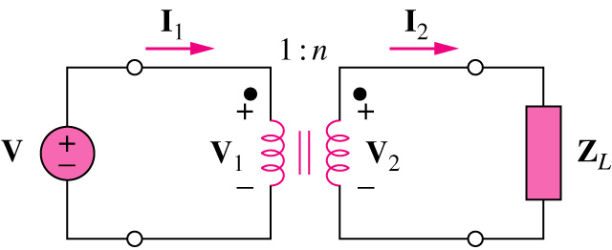
13.5 Ideal Transformers
An ideal transformer is a unity-coupled, lossless transformer in which the primary and secondary coils have infinite self-inductances.
V2>V1→ step-up transformer
V2<V1→ step-down transformer
Ideal Transformer
Circuit symbol

Slide 45
+
+
-
-
1: n
+
+
-
-
1: n
+
+
-
-
1: n

Slide 46
Transformer as a matching device
+
+
Z_{L}
Thevenin equivalent
-
-
1: n
Zin
1: n
Z₁
Z₂
Z₁
Z₂/n²
V_{s1}
V_{s1}
V_{s2}/n
V_{s2}
I₁
I₂

Slide 47
1: n
Z₁
Z₂
n² Z₁
Z₂
Vs1
nVs1
Vs2
Vs2
I₁
I₂

Slide 48
Transformer as a matching device
+
+
+
+
R_{L}
-
R_{L}/n²
-
-
-
1: n
1: n
R
R
+
+
+
+
n²R
-
-
-
-
1: n
1: n

Slide 49
Solving Ideal Transformer Problem
Method 1: Write out equations
Mesh analysis or Nodal analysis
Transformer VCR equations
Method 2 : Form equivalent circuit
Reflecting into secondary
Reflecting into primary
Z₁
Z₂
V_{s1}
V_{s2}

Slide 50
Example 4
An ideal transformer is rated at 2400/120V, 9.6 kVA, and has 50 turns on the secondary side.
Calculate:
the turns ratio,
the number of turns on the primary side, and
the current ratings for the primary and secondary windings.
Ans:
This is a step-down transformer, n=0.05
N1 = 1000 turns
I1 = 4A and I2 = 80A

